Slide 1
UTM
Universal Transverse Mercator
Coordinates
UTM Exercise
Locating the Grid
UTM Guide
USNG Sheet

Slide 2
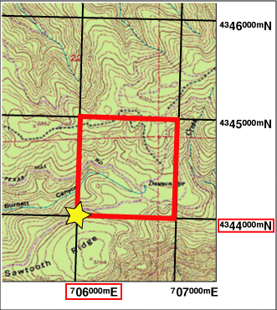
This 1km square is located at 706km E 4344km N
Usually we need to be a bit more precise about a location!

Slide 3
Using UTM is Easy
Take a look at the “UTM Practice Map” handout.
Can you quickly determine what map feature is at: 755.2 km E 4255.4 km N

Slide 4
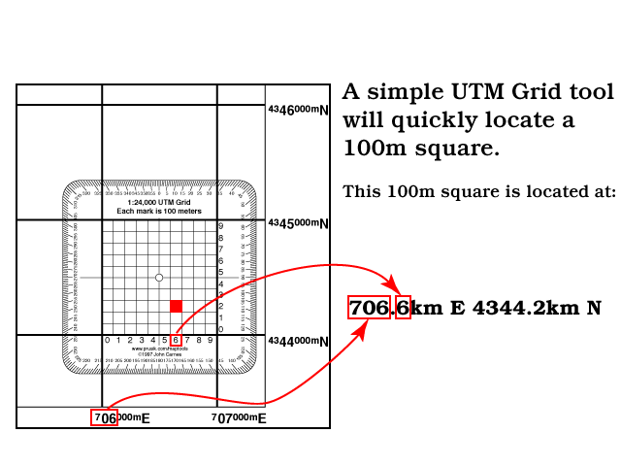
100m square example

Slide 5
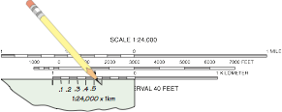

Slide 6
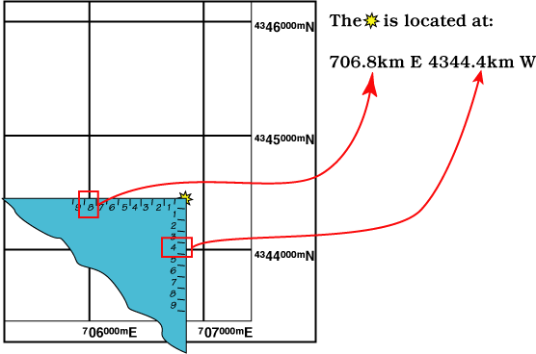

Slide 7
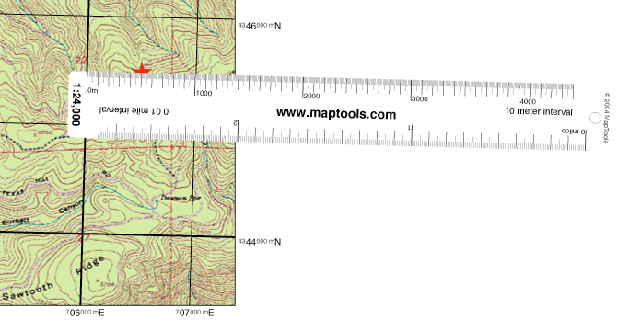
Using a distance scale, marked in meters, to measure UTM coordinates

Slide 8
There are many ways to write the same position...
P
r
e
c
i
s
i
o
n
|
|
V
Kilometers
Meters
755km E 4255km N
755000m E 4255000m N
755.2km E 4255.4km N
755200m E 4255400m N
755.23km E 4255.48km N
755230m E 4255480m N
755.234km E 4255.483km N
755234m E 4255483m N
755.200km
755 200m

Slide 9
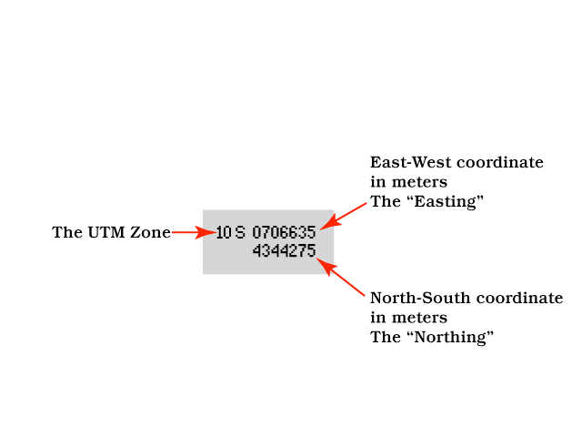
UTM Display on a GPS Receiver

Slide 10
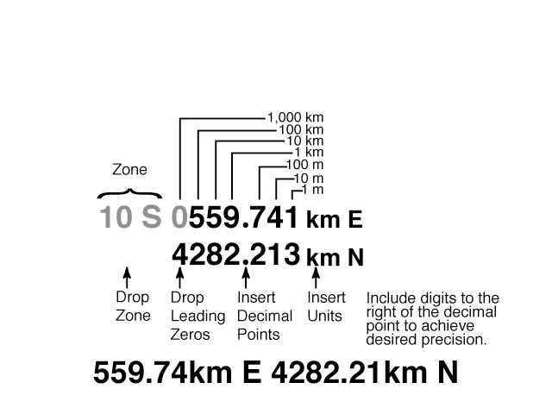
Reporting your position in UTM kilometers

Slide 11
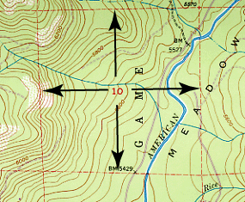
This is a
Township & Range Section,
NOT a UTM Grid

Slide 12
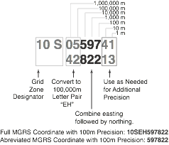
U.S. National Grid (USNG)
Coordinates

Slide 13
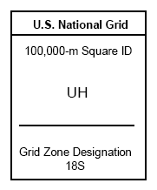
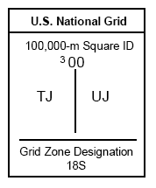
Printed Grid Reference Box

Slide 14
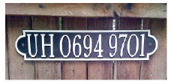
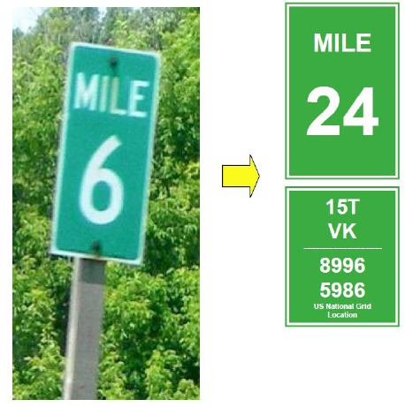
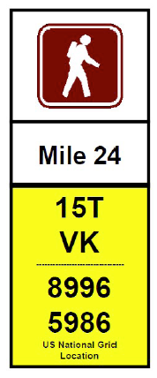
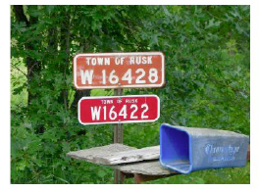
U.S. National Grid
could make many location signs
“GPS Compatible”
House Numbers
Upgraded Highway Mile Post
Trail
Markers
Rural Fire Numbers

Slide 15
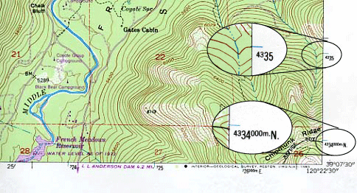
UTM Coordinate Markings on USGS Topographic Maps

Slide 16
Make a mark between digits
from the grid within the grid
USGS
1:24,000
1000m grid
Campus Air Photo
1:5490
100m grid
755230m E 4255480m N
587460m E 4124620m N
755.23km E 4255.48km N
587.46km E 4124.62km N

Slide 17
Plotting and Reading UTM Classroom Exercise

Slide 18
More about UTM

Slide 19
Transverse Mercator Projection
Central meridian is selected by the map maker and touches the cylinder.
Maps using the projection can show the whole Earth, but directions, distances, and areas are reasonably accurate only within 15° of the central meridian.

Slide 20
UTM Zones
World is divided into 60 zones.
Each zone is 6° of longitude wide.
Zones are numbered 1 to 60, starting at 180° and progressing to the east.

Slide 21
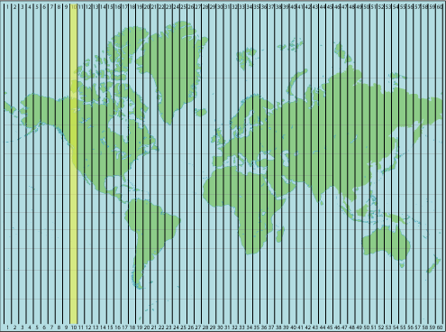
UTM Zones

Slide 22
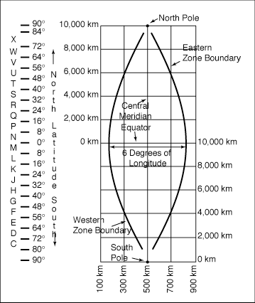
UTM Zone Details

Slide 23
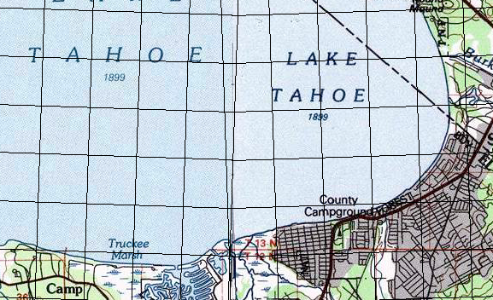
Boundary between UTM zones

Slide 24
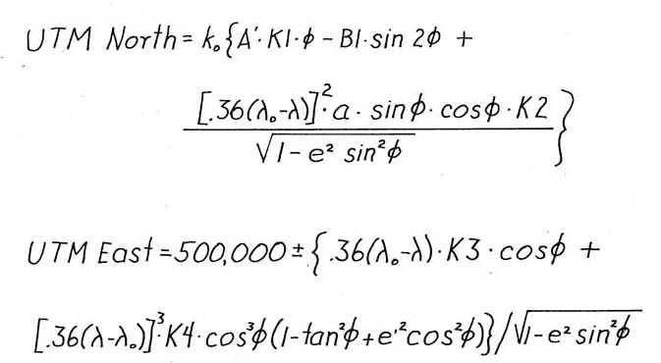
Converting Lat/Lon to UTM

Slide 25
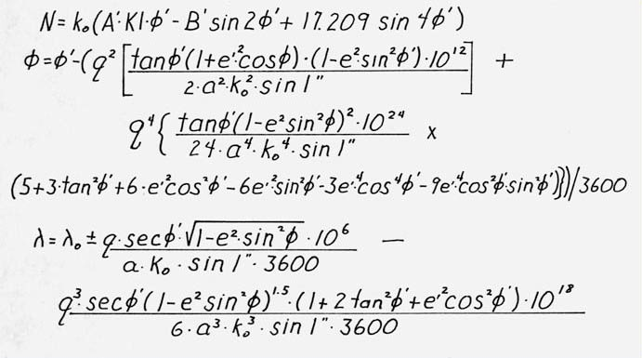
Converting UTM to Lat/Lon

Slide 26
Converting between Lat/Lon and UTM
Save a waypoint in the position format you have the coordinate in.
Switch to the position format you want to convert to.
Recall the waypoint

