Slide 1
Latitude / Longitude

Slide 2
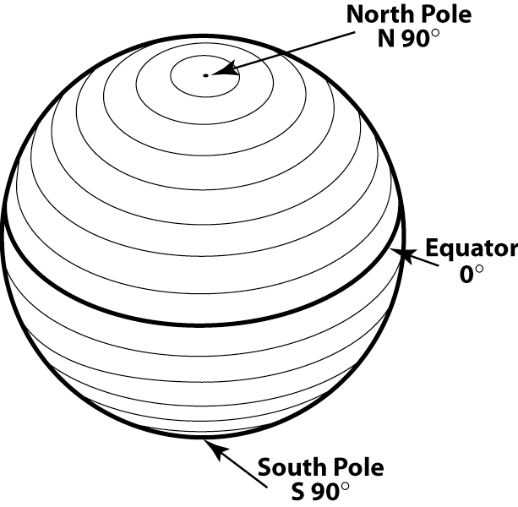
The Equator and Parallels of Latitude

Slide 3
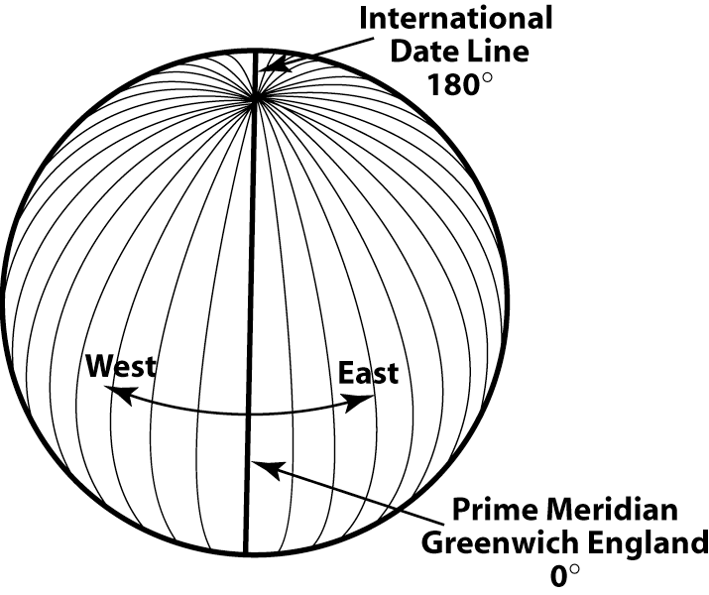
Longitude

Slide 4
The Prime Meridian
Today the world has agreed the the Prime Meridian or 0° line of longitude runs through the Royal Observatory at Greenwich, England.
Prior to the 1884 International Meridian Conference, most countries defined their own prime meridian running through their own capital city.
The French did not abandon use of their prime meridian, which ran through the Paris Observatory, until 1911.

Slide 5
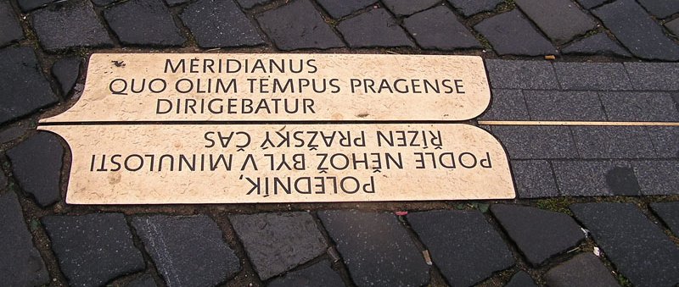

Slide 6
Longitude was difficult to measure at sea
Your longitude is the time difference between high noon at a known longitude (A ship’s home port for example.) and high noon at your current location.
How many degrees does a one hour time difference represent?

Slide 7
No Clock
No Longitude
Notes:
It was very hard to design a mechanical clock that would keep accurate time for many months at sea.
Many ships “touched the rocks” and sank because they did not know their longitude.
Once ships had clocks, most ports developed a noon whistle or “ball drop” to accurately mark noon, so that ships in port could adjust their clocks.

Slide 8
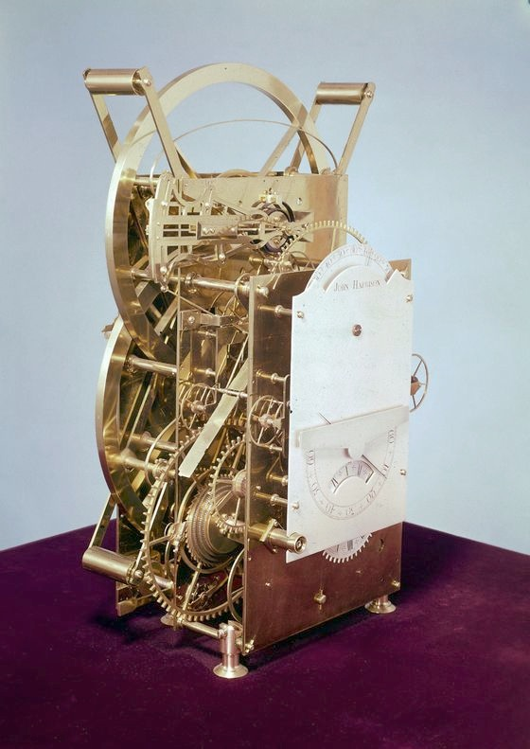
H3
John Harrison
1740-1757
National Maritime Museum, Greenwich, London, Ministry of Defence Art Collection

Slide 9
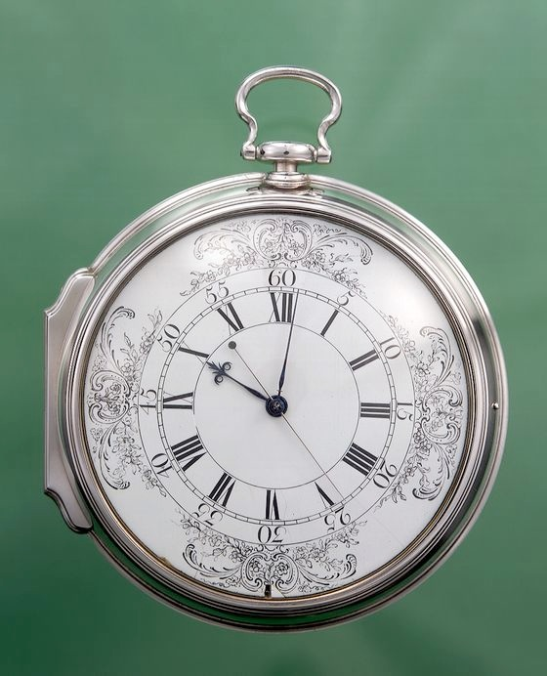
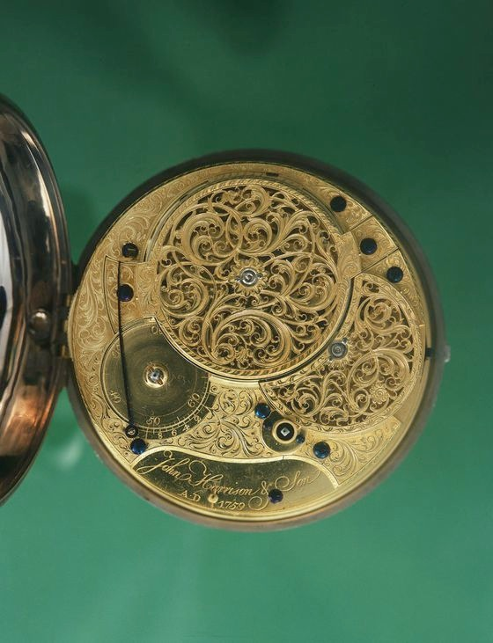
H4
John Harrison
1755-1759
National Maritime Museum, Greenwich, London, Ministry of Defence Art Collection

Slide 10
If the history of navigation intrigues you, I’d suggest you read…
Longitude: The true story of a lone genius who solved the greatest scientific problem of his time.
By Dava Sobel
Also as a PBS Nova show.
On DVD, Netflix has it.

Slide 11
Degrees, Minutes, and Seconds
Because measurement of latitude & longitude were so closely tied to time, it made sense to subdivide degrees into minutes and seconds.
A degree is made up of 60 minutes
A minute is made up of 60 seconds

Slide 12
DDD° MM' SS"
A latitude / longitude coordinate would be written like…
N 37° 22' 30" W 122° 15' 45"
Notes:
Where does the hemisphere go?

Slide 13
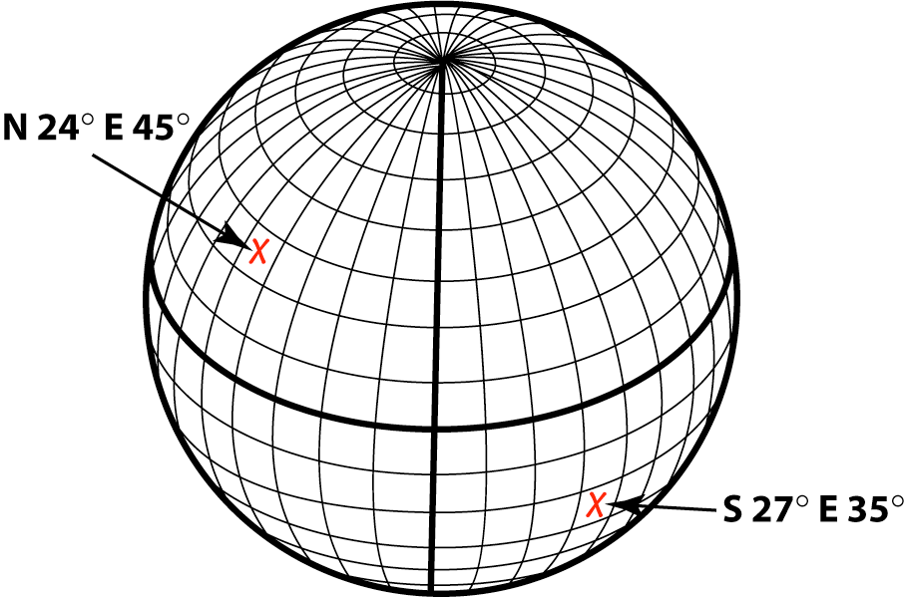
W

Slide 14
DDD° MM' SS"
A latitude / longitude coordinate would be written like…
N 37° 22' 30" W 122° 15' 45"

Slide 15
DDD° MM.MMM'
It is now common place to write lat / lon coordinates in a “decimal minutes” format.
N 37° 22.5'
W 122° 15.75'

Slide 16
DDD.DDDD°
Many computer based systems report lat/lon in decimal degrees.
N 37.3750°
W 122.2625°

Slide 17
Units Matter
It is important to include all of the units and notation.
It’s N 37° 22' 30" W 122° 15' 45” Not 372230 1221545
Notes:
Correct coordinates are occasionally a matter of life and death.
Don’t sacrifice clarity due to laziness!

Slide 18
Using Lat/Lon is Tricky
Take a look at the “Lat/Lon Practice Map” handout.
Can you quickly determine what map feature is at:
N 38° 36' 22" W 120° 03' 58"

Slide 19
Plotting Lat/Lon Video

Slide 20
Reading Lat/Lon Video

Slide 21
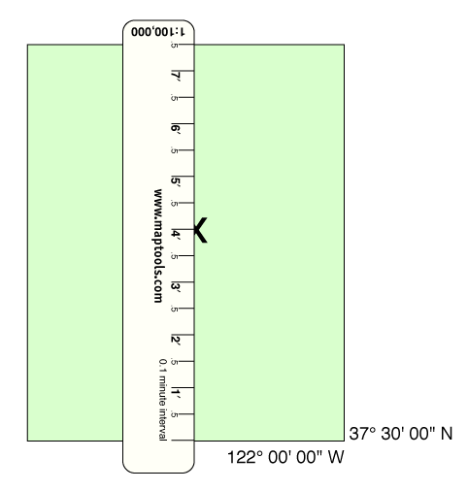
Measuring Latitude

Slide 22
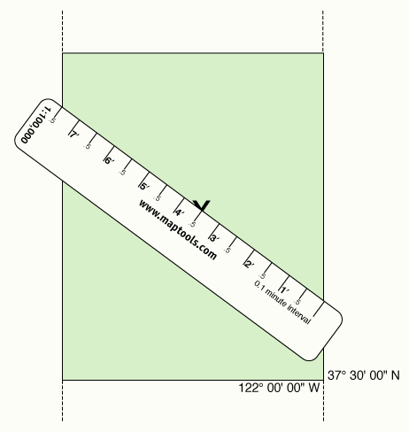
Measuring Longitude

Slide 23
Lat/Lon Coordinate Exercise

Slide 24
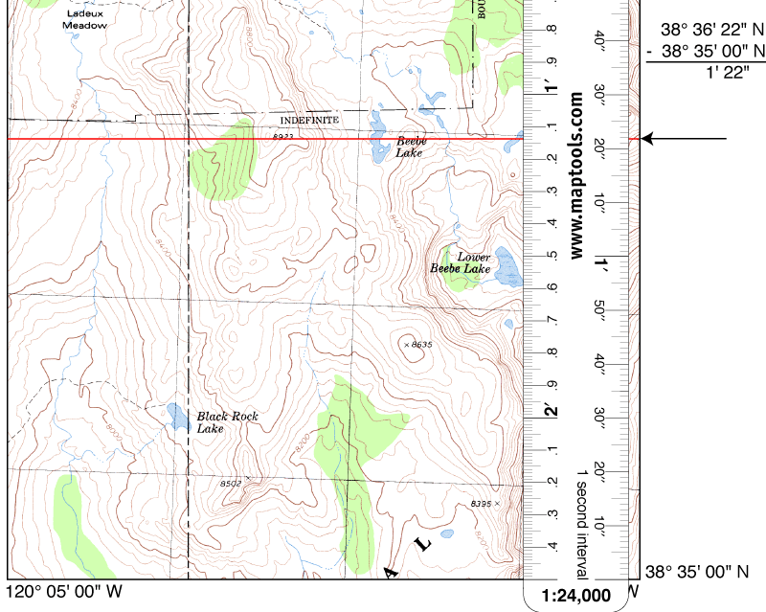

Slide 25
